Slide 1
Interim Project Pitch
By Thomas Simmons
K1906250

Slide 2

America Down Under
Very recognisable characters
All the Playable characters in Logo
Not been a Trump game of this genre
Development of the Logo

Slide 3
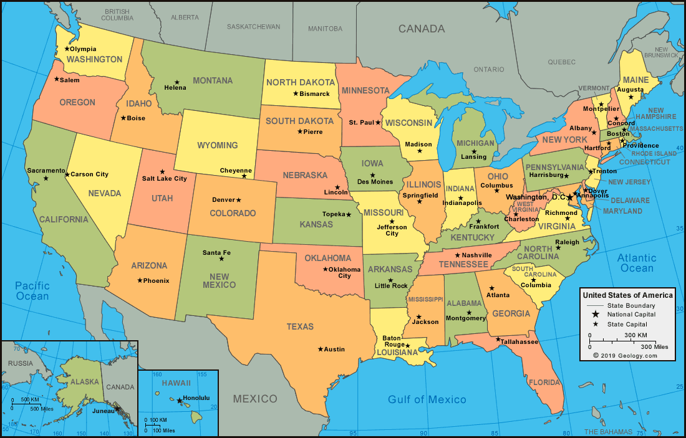

Game Outline/Story
Based in America in 2021
Political Civil War
Third Person Shooter Role Playing Game
Secret serviceman guide
Fake Allies
Corruption

Slide 4
Current Games Similar to mine What I got Inspiration from

Slide 5
Target Audience Survey Results
Used Survey Monkey and posted over social media
(Results)
(Questions Asked)

Slide 6





Target Audience/Profile
Target age of players: 16+
PEGI/ ESRB rating: 16
Players who like Tactical, Exploration & Social Games
Intended game systems: Android/Apple Mobile or console depending on survey results

Slide 7
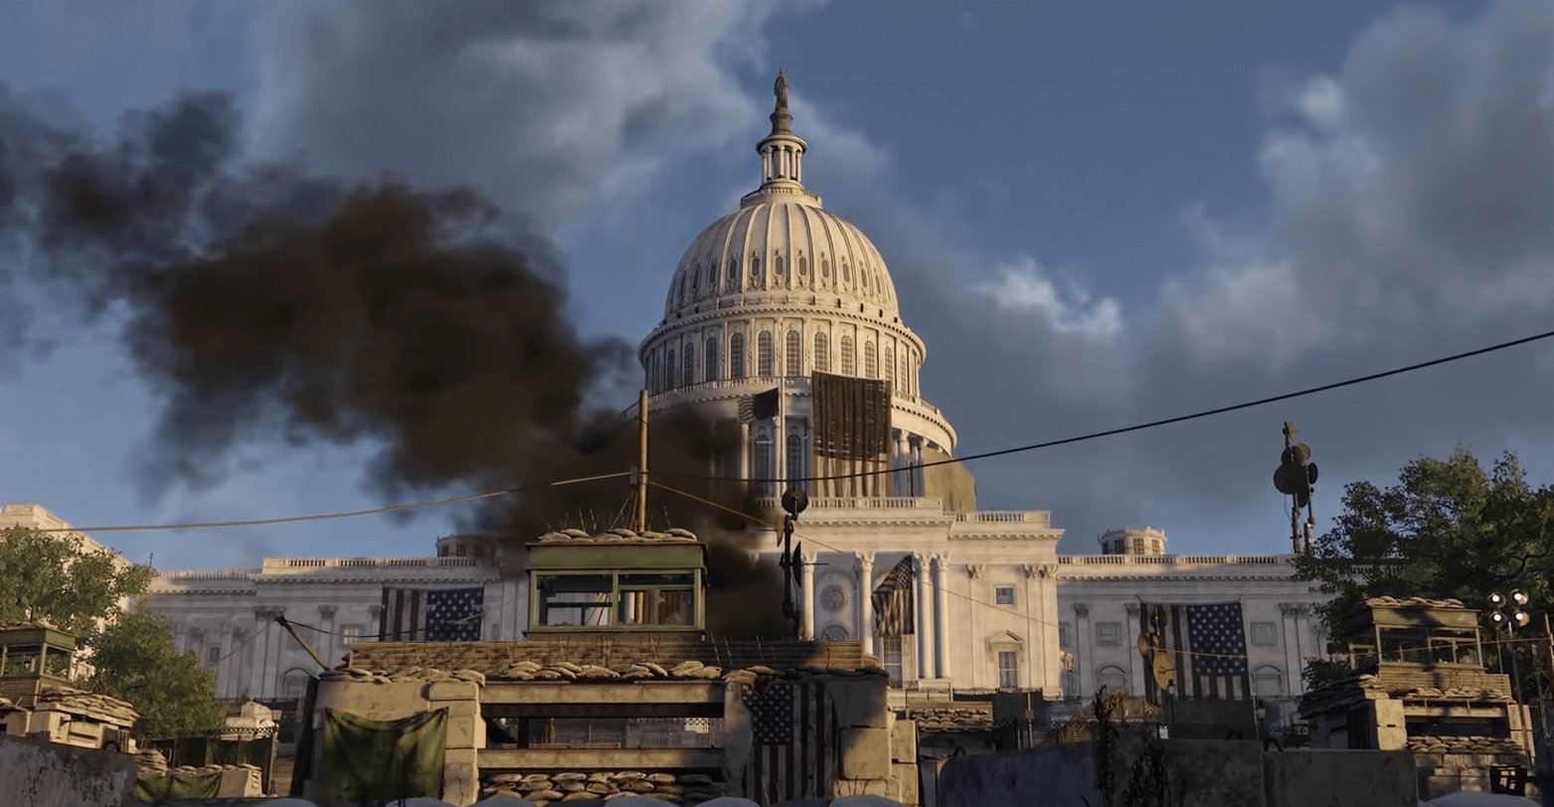
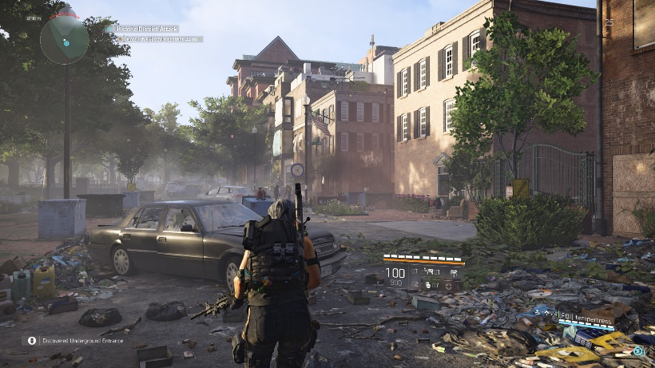
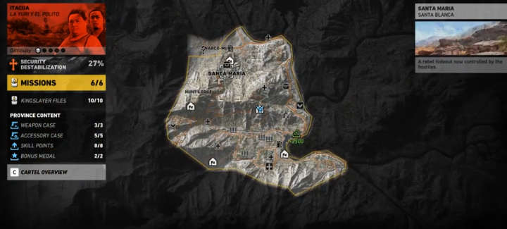
Gameplay & Environment
Moving across the map to try and escape America
Gather influence/ collectables to earn in game currency
Player character dies, respawn at last save
In the levels the player is introduced to new abilities
Empathise with rivals/enemies
Encounter Political characters/Rivals
Collect articles (Intel) objects in game

Slide 8
Game Experience
Players will feel sadness towards America and the state its in
Destruction, no hope, frustration
Signs of overgrown vegetation
Fun/ laugh towards characters being used

Slide 9
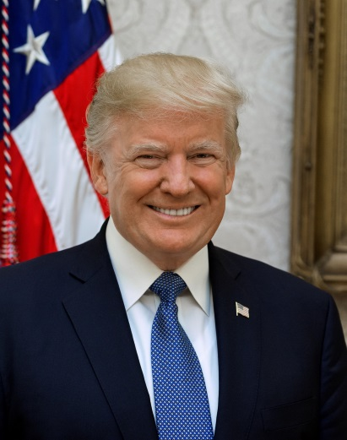
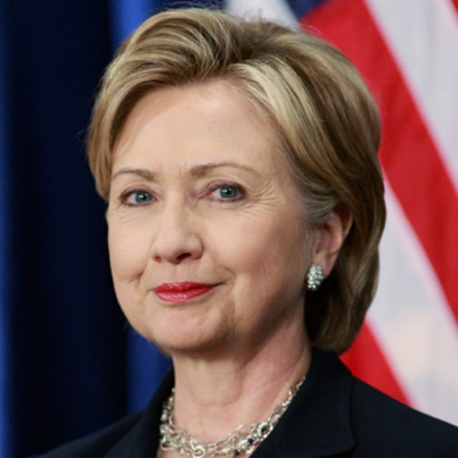
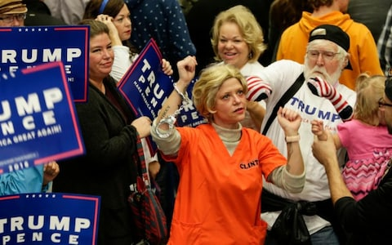
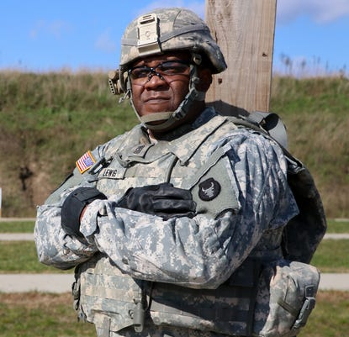
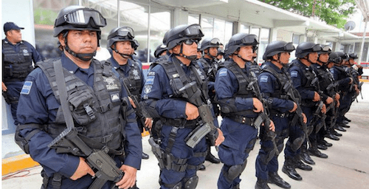
Characters
Players Characters
Allies (Trump enthusiasts/voters)
Enemies (Rival Politicians, American People)
Heroes (Party Members, Secret Service)
National Guard & Police
Mexican Police & People
Russian Influencers

Slide 10
Characters Story Arks

Slide 11
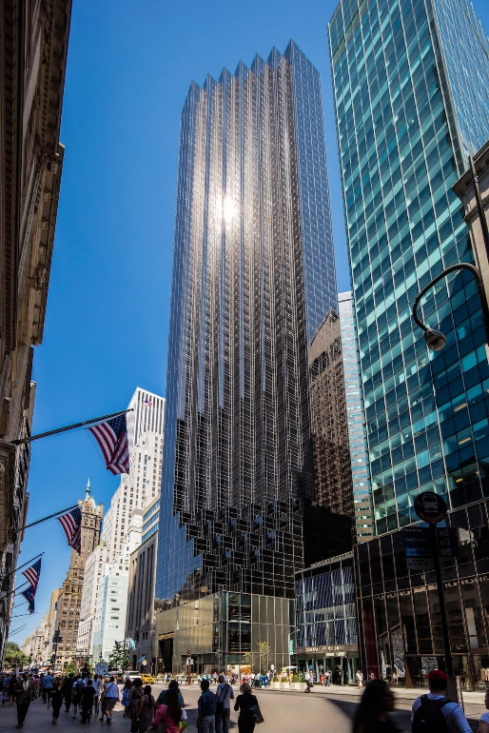
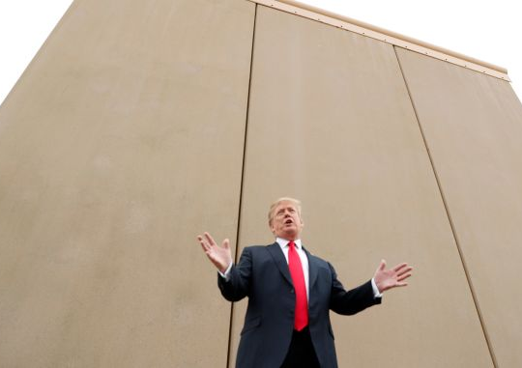
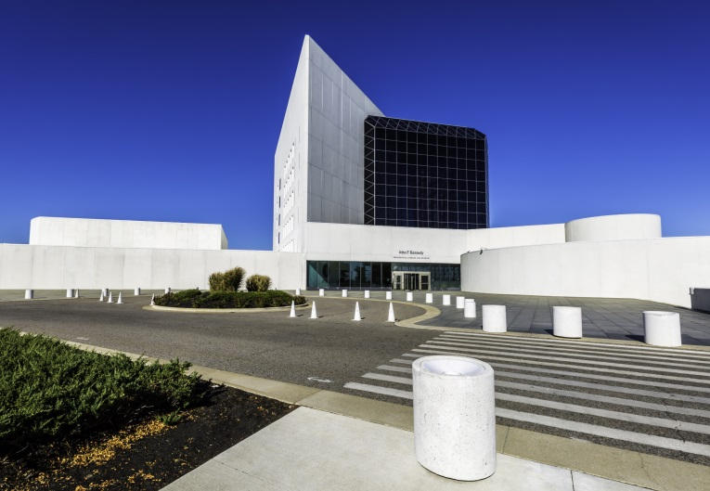
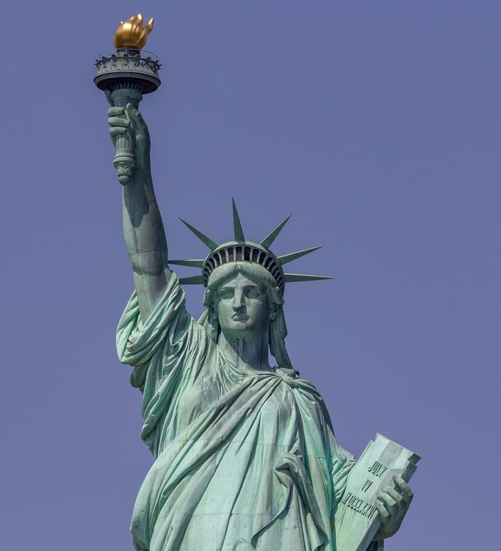
World/Locations
Iconic Buildings/ structures (Mexican wall) represented
Cities and states provide difficulty level and rewards
Map of America
Audio included in different scenarios
Find intel of real world articles/ news stories

Slide 12
Game Mechanics
Players interact with objects
Can find and pick up weapons/ armour
Encounter traps/ hazards human/ naturally made
An assistance menu/ menu

Slide 13
In Game Purchases
Purchases of different armours/ bullet proof vests
Outfits for characters
Purchased allies such as mercenaries/ secret servicemen
Loyalists/ Trump enthusiasts
Seasonal Customisations

Slide 14
What else to Include
Core and Additional game loops
Progression chart (with and without DLC’s
Game world view (include political status bars
Designs of main, side and activity mission icons
Representation of cities in states

Slide 15
Questions?

